Slide 1
Chronicle of a death Foretold
Year 6ELL

Slide 2
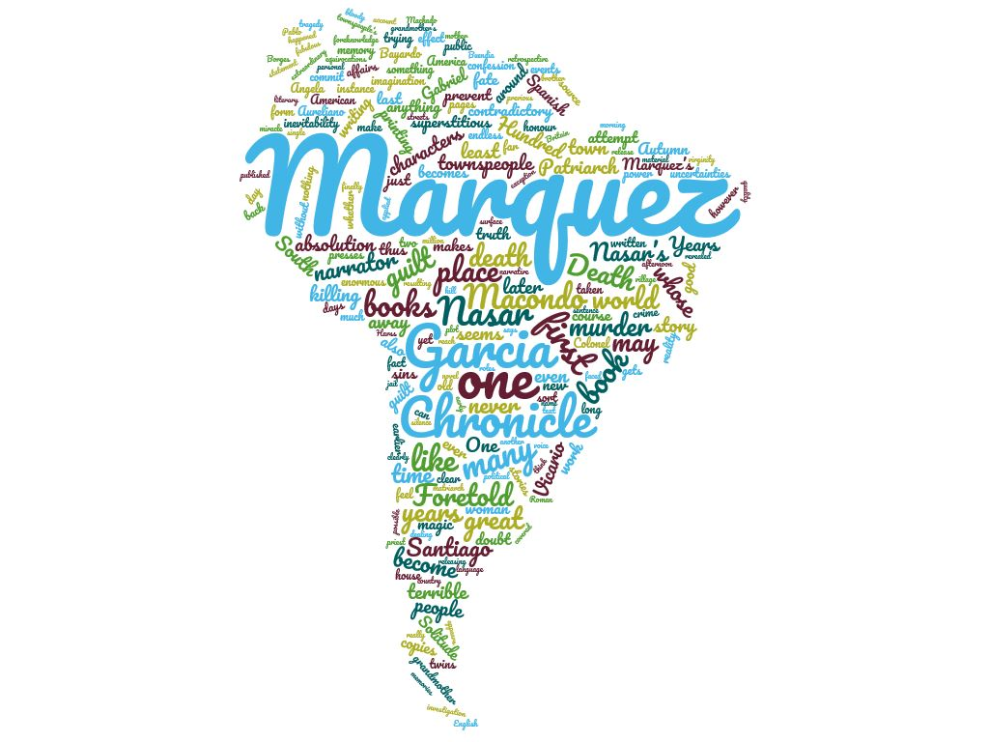
Themes in CoADF
Rituals
Responsibility (Societal and as an Individual)
Honour / Obligation / Social Expectations
Inevitability/ Foretold / Fate / Lack of Freedom
Uncertainty / Ambiguity / Mystery
Reconstruction / The Search for Truth
Isolation / Alienation
Conflict & Violence: Gender, Class, Age
Justice: Retributive, Restorative, Distributive

Slide 3
Rituals
Rituals are an attempt at bringing order. Santiago enjoys the ‘pomp’ of the Bishop’s visit but displays no religious leanings.
Often more important in divided/unequal societies (context)
Rituals bring together profane/sacred, dead/living, rich and poor.
In the novel, rituals can be mundane (daily routines of the town’s tradespeople) or more elaborate (marriage, religious celebration).
Love, religious fervour, and revenge are all carried out within the public space: The Vicario sisters mourn their dead sister by “observing a mourning that was relaxed inside the house but rigorous on the street”
Angela’s letter writing fills little purpose but to show her love/absolve her guilt. Bayardo San Roman thus does not need to read the letters. As long as ritual has been performed.

Slide 4
Rituals
Several forms of ritual
Ritual killing: Santiago is put to death in the middle of the town square in a description that echoes a Bull ring. Origins as a sacrificial event. Associated with religious festival and royal weddings. Considered a noble sport for the rich: Contrast and inversion as the poor brother Vicario kill a rich man. Bayardo San Roman has " the waist of P a novice bullfighter”. The local policeman is gorred to death by a bull during a festival the following year.
Sacrificial act: Reference to the vestal like nature of the Vicario sisters(See comprehension notes).
“The people had stationed themselves on the square the way they did on parade days. […]he was so confused he couldn't find his way home. “They began to shout at him from every side, and Santiago Nasar went backward and forward several times, baffled by hearing so many voices at the same time. => disorientated animal.
The twins carried out their killing almost mechanically. Following rites but do not seem to be truly be in control.

Slide 5
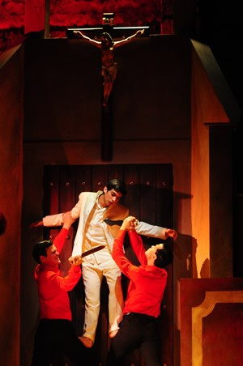
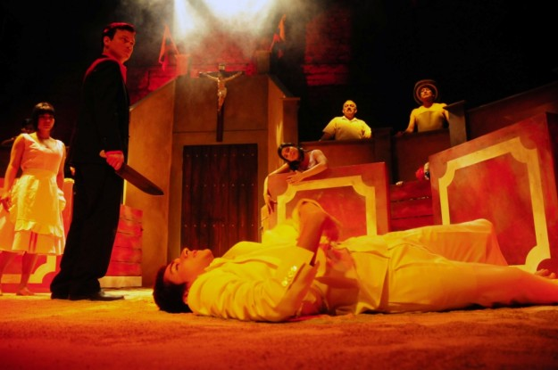
Rituals
Stage setting for a modern production of COADF:
Notice that the stage is set as bull ring (right). Sacrifice and crucifixion also refer to religious rituals (right).

Slide 6
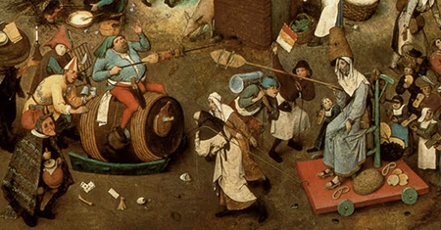
Rituals
Carnival
“A carnival-like text, a theatrical spectacle in which there is no distinction between actors and spectators, Chronicle makes all its characters actors who are guilty of the crime and participants in it, and culminates with their attendance at Santiago Nasar’s murder in the square shown as a public act. To comprehend this theater of symbolic signs, we must interpret the names of the characters, the place of sacrifice, and the role of the community in the novel.” -Source
Wedding, drunkenness and Bishops visit create a carnivalesque atmosphere.
Carnival is a time of inversion where reality and imaginary collide.
Historically used as a pressure valve (social conflict and social class) “the European festival generally encouraged a temporary social-cultural inversion of social hierarchy,”- Source

Slide 7
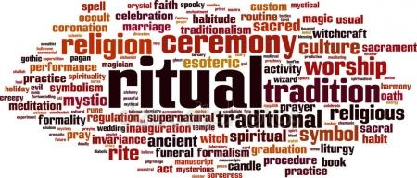
Rituals
Ritual in the structure of the text:
Repetition: The narrator keeps going over the events. Adding minute details.
Similar scenes are described several times.
The same words are used over and over again. The novel becomes a form of reenactment of the crime committed. On the day they were going to kill him," "They've killed Santiago Nasar" and "It was the last time they saw him alive," => Incantation, ceremonial proceedings.
The act of writing the chronicle itself becomes a ritual.
Ritual as a desire for absolution of “guilt”

Slide 8
Rituals
Link to 1984:
The ‘two minutes of hate’pp12-19
Daily rituals used in an oppressive society.
Making sense of what is meaningless.

Slide 9
Responsibility
Everyone knew but nobody did anything.
Characters tend to give reasons/excuses for not intervening.
Diffusion of responsibility: No one acts when in a group: Links to the historical context as Colombia’s civil society and its leaders seemed powerless to intervene in La Violencia and the cycle of violence.
Some characters seem to accept responsibility and suffer consequences: Placida Lucida “never forgave herself” p98 but “with the passage of time she freed herself from blame” p98. blames herself for misreading the dream: avoids the fact that she locked the door.
Many characters mention code of honour or fatality as a way of absolving themselves. But most of those who could have done something to prevent the crime and did not consoled themselves with the pretext that affairs of honor are sacred monopolies, giving access only to those who are part of the drama”p97

Slide 10
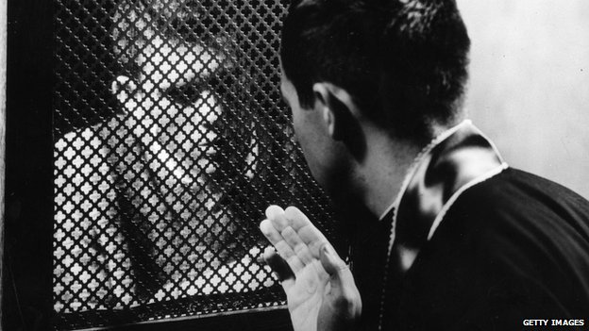
Responsibility & Guilt
Context: Catholic background
Importance of absolution through confession. Naming and stating precisely allows for absolution hence the digression and personal anecdotes.
The brothers go to the priest who sees their surrender “as an act of dignity”p49
Guilt permeates the work: Citizens become obsessed with Santiago’s story: “For years we couldn’t talk about anything else. Our daily conduct, dominated then by so many linear habits, had suddenly begun to spin around a single common anxiety” p96.
For some characters it seems too much: “Hortensia Baute, “whose only participation was having seen two bloody knives that weren’t bloody yet, felt so affected by the hallucination that she fell into a penitential crisis, and one day, unable to stand it any longer, she ran out naked into the street” p97=> Christian and catholic imagery.
Yet the town struggles with guilt. 27 years later, most characters are still willing to talk and attempt to “put the broken mirror of memory back together from so many shattered shards.”p6

Slide 11

Responsibility & Guilt
The brother refuse responsibility. They actually invoke the code of honour as overriding God’s words “ We killed him openly,” Pedro Vicario said,”but we’re innocent.”/Perhaps before God,” said Father Amador./”Before God and before men,”Pablo Vicario said.”It was a matter of honor” p49
At the prison where they are sent for 3 years the twins never showed” any indication of remorse”p49.
However, there is a suggestion they experienced guilt: p78 the brothers cannot get rid of Santiago’s “smell” (cf Lady MacBeth). Pablo’s diarrhea may be an expression oh his guilt. We learn later that he is old and married happy. Pedro cannot ‘let go’ and the readers learns later he disappeared while on patrol with the army.

Slide 12
Honour
The quality of knowing and doing what is morally right.

Slide 13
Honour
Honour is key in the community. To not have honour would lead to rejection. This might explain why no one intervenes. Honour is as much about public opinion as it is about moral codes.
Honour is so important the lawyer uses it as a valid defense. p48. “homicide in legitimate defense of honor”.
Linked to machismo/gender representation. “ The brothers were brought up to be men. The girls were reared to get married” p31=> difference between ‘to bring up’ and ‘to rear’ someone (connotation with husbandry for the latter).
The word is repeated throughout the text. After the crime the twins feel “comforted by the honor of having done their duty”p79.

Slide 14
Honour & Women
Women’s honour is public shared with community during wedding and must thus be redeemed publicly.
Honour is coded and highly ritualized. Women also expect it from men “ I never would have married him if he hadn’t done what a man should do”p62.
Honour may also refer to a women’s virginity (old-fashioned).
Women belong to the public space: their actions are judged in public and their sexuality assessed in public. Men do not have to worry with such things. The narrator, the twins, Santiago and their friends all spent time at the brothel the night before. However, the community seems fine with safeguarding their privacy.

Slide 15
Honour
Honour in COADF is not so much about right or wrong. (Consider the twins’ hesitation).
Honour in COADF is about maintaining the appearance of moral conformity.
Twist and inversion: This makes Santiago the victim ‘culpable’ and the twin brothers ‘heroic’
Societies concept of honour condemns Santiago before and after the crime. His last words “They’ve killed me” take on a new meaning here.
Contradiction: most character’s morality is dubious (prostitution, STDs, drinking, lying,…). What does that tell us about the community? How might this tie in with the religious fervour exhibited on the day the bishop is visiting?

Slide 16
Honour & Social expectation
Women
Women are keenly aware of their place in society and their role in the honour system.
There are multiple references to shame/frustration/humiliation by women:
The narrator’s sister: “I felt I was the one who was going to die”p21
Pablo’s fiancé: encourages him to kill.
Flora Miguel: “She went through a crisi of humiliation”p112
Angela Vicario is weary she will be humiliated by Bayardo San Roman at her wedding p41.
Conservative Christian (context): Gender roles and the original sin/ Women’s collective responsibility/ Women as the embodiment of community.

Slide 17
Honour & Social expectation
Context:
Honour is a cultural value and as such is closely connected to the context:
South American Machismo
Family ties/Blood ties
Religion/virginity
Social class
Violencia: Santiago seems to die without honour. He runs away before falling crying for his mother. His intestines falling out. The smell he leaves behind is a smell of shit. This may be an allusion to the fact that the civil conflict denied its victims a dignified death/memory.

Slide 18
Fate
Fate and Foreshadowing present in the title and the first sentence. “On the day they were going to kill him, Santiago Nasar got up at five-thirty in the morning to wait for the boat the bishop was coming on.” p1.
The second sentence reveals he had a strange dream the night before his murder and then failed to “recognize the omen” and his mother did not notice any “ominous augury” in his dream p4.
Does Santiago know? The rabbit scene p10 “make believe it was a human being”.
Inevitability (context civil conflict and fatalism).
Fatalism as a justification for inaction.
Use of semantic field of fate and tragedy : “The Fatal Door” p12, “mortal mistake” p110. creates an inevitable progression towards Santiago’s murder. => predestination
However:
Opposition with the narrator’s insistence this was a crime/ with his will to piece back together the story he seems to imply there was a choice:
An opposition of Fate and Free-will.

Slide 19
Fate
Fate is also used to look at genre and style:
COADF assumes certain stylistic element of classic tragedy.
Harmatia: a fatal flaw/error of a tragic Greek hero: Did Santiago commit the sin he’s accused of? That would be his flaw.
Hubris: Excessive pride: Santiago can be seen as proud and dominant with women.
While the plot does not follow the classic scene in three acts, just as in a tragedy the audience knows the hero will meet a tragic end.
Narrator as the chorus. Retells the story and leads the audience.
Appeal of tragedy: even the princes slip and are the architects of their own downfall (social class division and retribution: see context). Greek theatre fulfilled important social purposes for upper and middle class. Keep power in check and avoid chaos and disorder).

Slide 20
Considering Paper 2
How do the two writers you have studied foreshadow events or ideas to come later in their works, and what is the effect of such foreshadowing?

Slide 21
Uncertainty and Mystery
Dreams & Magical Realism: Marquez describes his events as real yet actions and characters are sometime so bizarre that it is hard to understand what is real.
Narrator returns to the town to find out more about the murder yet this is inferred from the text as the narrator gives little explanation at the circumstances of his return.
Very little information is given about the villagers. Only the bare minimum. Actually the information given is often anecdotal and apparently irrelevant.
Unreliable witnesses p4: people cannot remember whether it was raining or the sun was out/ Inability to even figure out what the weather was on that day. Click here for a good essay on point of view and perspective.
Unreliable narrator: The narrator acts as a journalist/investigator. This creates trust from the audience. Detached and objective in appearance but how can we trust him? P8 Narrator describes Santiago as “merry and good-hearted” yet Victoria Guzman describes him as a predator.

Slide 22
Uncertainty and Mystery
Link to social context: Violencia and collective trauma different stories and different perspectives. Is it possible to reconcile different sides?
Violencia: Not an ordinary civil war. Politics got mixed up with local rivalries, class animosity, land disputes and organised crime.
Community and tradition: difficulty in establishing right and wrong (See honour)
literary critic: Creates a differing reading experience/ no final point of view/ reading changes with the reader’s context. See existentialism: nothing makes sense. We can attempt at organising random events but ambiguity will always exist.

Slide 23

Reconstruction
“Broken mirror”p6 The novel is an attempt at piecing back together the true story.
Over a hundred quotes collected.
The civil judge tried to piece things together. Nothing new is revealed about the murder that was not already stated in the official report made by the investigating magistrate
The narrator’s visit to the archive (flooded room): Inside an old colonial building: the weight of history (context) makes piecing the story impossible.pp98-99
Memory and distortion
Modern novel as “collage”

Slide 24
Isolation and Alienation
Political and social context
Existentialist alienation (context: Marquez lived in France while such ideas were trending throughout the literary and academic world).
Images of decay: Widowers Xius’s old house after the incident. Decaying certainty and institutions. Church, army, politics do not supply answers or certainty.
Corrupt religious institutions: The bishop does not stop despite the fact that many villagers have gone to great lengths to make it a memorable day. He is also presented as wasteful and greedy (“comb soup”).
As a result, individuals no longer have social, religious and political mores to give them a sense of place a direction. Context: Colombia and its post-colonial history.

Slide 25
Isolation and Alienation
Political and social context
Exitentialist alienation (context Marquez lived in France while such ideas were trending throughout the literary and academic world).
Images of decay: Widowers Xius’s old house after the incident. Decaying certainty and institutions. Church, army, politics do not supply answers or certainty.
Corrupt religious institutions: The bishop does not stop despite the fact that many villagers have gone to great lengths to make it a memorable day. He is also presented as wasteful and greedy (“comb soup”).
As a result,

Slide 26
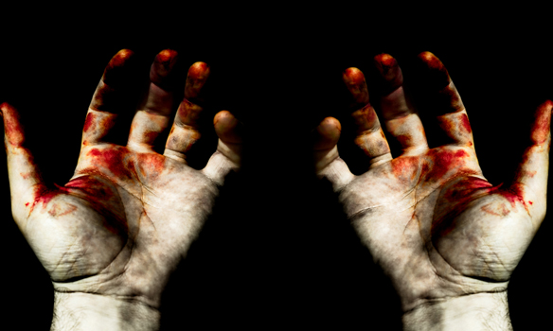
Conflict & Violence
Numerous graphic depiction of gore and violence in the novel: the murder and aftermath, autopsy but also in everyday life (rabbits).
Links to rituals (evisceration)/sexual violence

Slide 27
Conflict & Violence
Social/Class conflict in COADF
One critic mentions "the confluence of economic, personal and possibly political interest…underlying Santiago Nasar’s death”
Can you you identify some these interests in the text?

Slide 28
Conflict & Violence
Economic: Santiago is a land owner. Wealthy. Uses his money for leisure.
Personal: Santiago is of middle eastern decent. Not a blue blooded Spanish elite. Colonial history of Colombia.
Politic: Multiple references to military men and military past: Bayardo San Roman is rumored to have ”wiped out villages and sown terror in Casanare as troop commander”p33. his father General Petronio is a hero of the civil war (see context) and has ordered opponents to be “shot in the back”p34.
Consider how institutions and their representative are presented: justice/the judge, administration/the mayor, army/San Roman’s father, church/ the bishop, Farther angel and Farther Amador => untrustworthy and corrupt elites. Physical description: usually aging men, portly and indecisive.

Slide 29

Conflict & Violence
Gender:
p63: “That day I realized how alone we are in the world.” Clotilde Armenta. Women are at the mercy of men.
Machismo: Latin social code : “a cult of virility, the chief characteristic of which are exaggerated aggressiveness in male to male interpersonal relationship and arrogance and sexual aggression in male to female relationship” - Evelyn P Stevens.
Closely linked to code of honour: enforced by community and both genders.

Slide 30
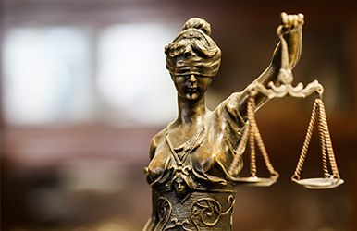
Justice
Justice: may be understood differently by different characters. The twin’s demand for justice (emotional) may be different from the magistrate’s (reason/legal) or the narrator’s demands.
Legal Justice: Institutions. It is represented by the judge/magistrate pp98-100 and other references in the text. Criticism of the Colombian Justice system:
  Unable to give a fair sentence.
  Lets the brothers off after 3 years.
  Magistrate files are important here pp98-100:

Slide 31
Justice
    Close Reading: pp98-100
    The brief is started late 12 days after the crime by a young novice magistrate “the magistrate was newly graduated and still wore his black linen law school suit and the gold ring with the emblem of his degree”p98: ring needed to show he actually is a magistrate. Anonymous: “I never discovered his name”p98.
    Evidence that the magistrate was distracted described as “a man burning with the fever of literature” p99. A dreamer, interpreting reality through prism of his fantasy. We are told he read the Spanish Classics.
    Intextuality is clear here: Don Quixote by Cervantes is the greatest Spanish classic. Don Quixote is a dreamer, elderly aristocrat who is half mad and has read too much romantic literature and goes off on futile and grotesque quests. Just as Don Quixote the young judge is a romantic “burning with the fever of literature” and “kept falling in lyrical distraction”.
    Don Quixote often used a symbolical image of decaying aristocracy and its value. Here the Colombian Bourgeoisie and its failures.
    Nietzche associated with Nihilism in contradiction with the precision, unambiguous statements and reason expected from a judge.
    The archive is a decrepit old Colonial building: We are told Sir Francis Drake stayed there: reference to the discrepancy between imported European law and the new continent they inhabit.
    Old Palace Of Justice: Symbol of dark colonial secrets and the oppressive nature of justice.
    The brief is incomplete and fragmented (see collage and Uncertainty)

Slide 32
Justice
Interestingly, After the failure of the judge we are immediately presented with another judge:
Angela Vicario. P100 “He was my perpetrator”. Her sentence is short and final. While enigmatic to some it does not echo the cryptic comments written in the margin by the magistrate.
Natural or community justice meted out by the twin brothers.
Linked to Honour and Machismo. Justice is about holding your right place in the community.

